Slide 1
Temporal Action Detection with Structured Segment Networks
ICCV 2017
宋 雪
18210860029

Slide 2
Abstract
This paper presents the structured segment network (SSN), a novel framework which models the temporal structure of each action instance via a structured temporal pyramid.

Slide 3
Contents
Introduction
Temporal Region Proposals
Structured Segment Network
Experimental Results
Conclusion

Slide 4
1.
Introduction

Slide 5
Introduction
paradigm
“proposal+classiﬁcation”

Slide 6
2.
Temporal Region Proposals

Slide 7
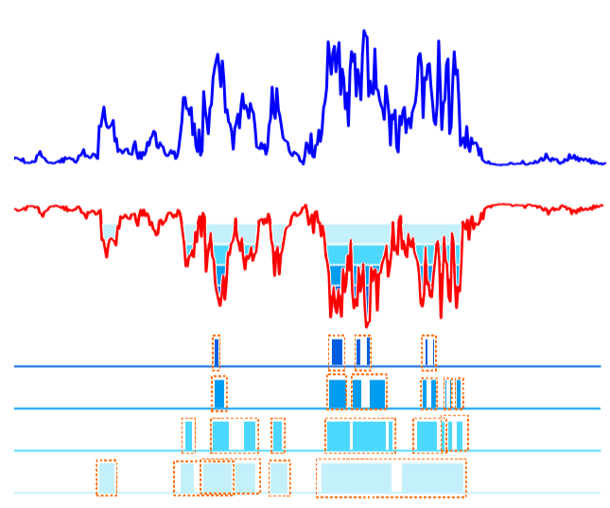
Temporal Region Proposals
Temporal Actionness Grouping(TAG)

Slide 8
3.
Structured Segment Network

Slide 9
Structured Segment Network
Overview
Three-Stage Structures
Structured Temporal Pyramid Pooling
Activity and Completeness Classiﬁers

Slide 10
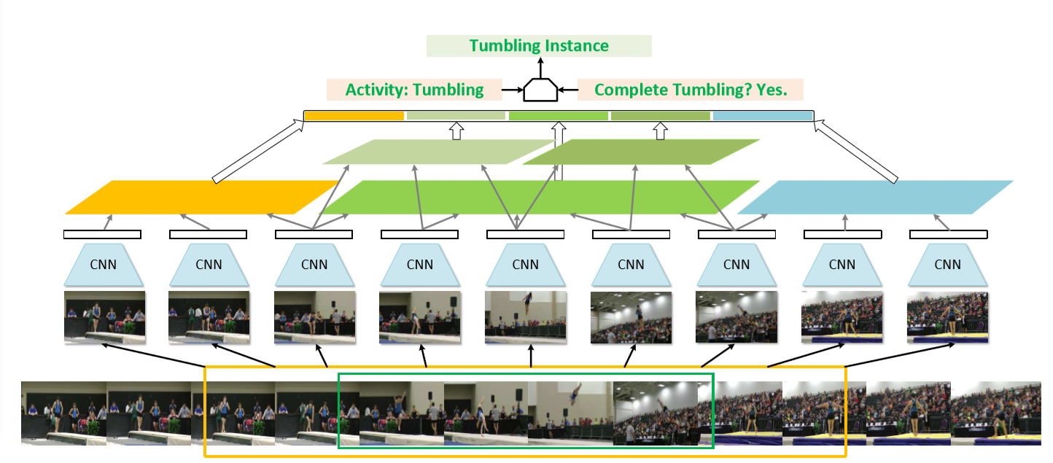
Overview

Slide 11
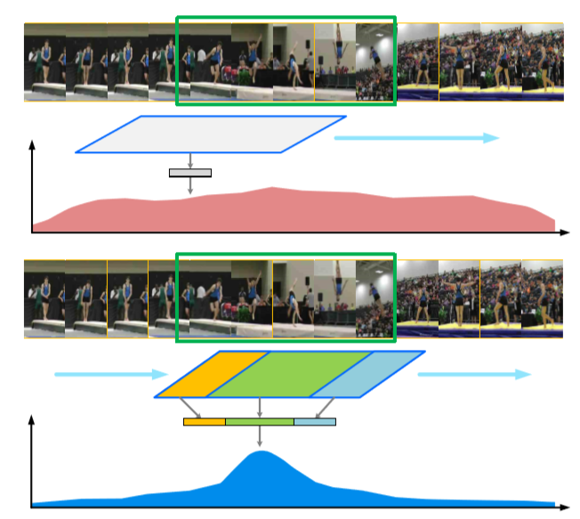
Three-Stage Structures
Given a proposal p=[s, e] and its duration d=e-s，set
[s-d/2, s] as starting
[s, e] as course
[e, e+d/2] as ending

Slide 12

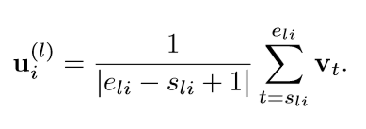
Structured Temporal Pyramid Pooling
compute the stage-wise feature vectors via temporal pyramid pooling
construct a L-level temporal pyramid where each level evenly divides the interval into B_{l} parts

Slide 13
Activity and Completeness Classiﬁers
Activity classifiers make predictions based on feature vector of course stage.
Completeness classifiers make predictions based on global representation.
Location regressors make predictions based on global representation.

Slide 14

Activity and Completeness Classiﬁers
Loss function
uniﬁed classiﬁcation loss
multitask loss

Slide 15
4.
Experimental Results

Slide 16
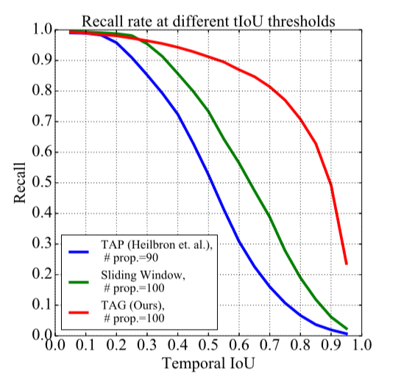
Experimental Results
The Quality of Proposals
IOU: intersection over union

Slide 17
Experimental Results
Evaluation Metrics
mean average precision (mAP) at different IoU thresholds

Slide 18
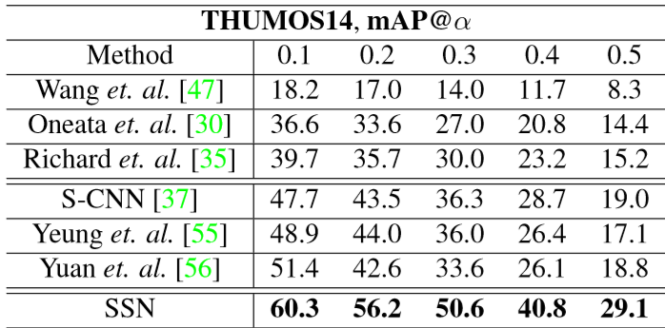
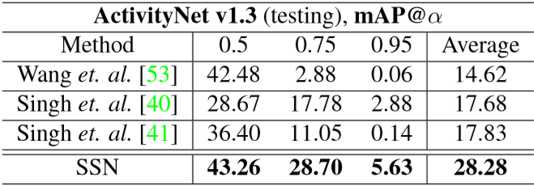
Experimental Results

Slide 19
5.
Conclusion

Slide 20
Conclusion
the capability of discriminating between complete and incomplete proposals
end-to-end fashion
superior detection performance on standard benchmark datasets

Slide 21
THANKS

